Slide 1
NFCC CAD and ICCS Supplier Engagement Day
Closed Morning Session : 9.30am – 12pm

Slide 2
Agenda – Morning session
Item | Activity | Time | Lead
1 | Welcome, introductions and apologies | 09:30 | Sally Conquest
2 | Purpose of today’s session and overview of team National Procurement Hub NFCC Ops Communications Strategy Board | 09:40 | Sally Conquest / Ian Taylor / Chris Else
3 | Commercial Considerations External Factors Market engagement and Industry feedback Routes to market Contractual terms Specification | 10:10 | Sally Conquest
 | Comfort Break | 10:50
4 | Working together - An assessment | 11:00 | Chris Else / Ian Taylor
5 | Open discussion / Lessons Learned sharing / Q&A | 11:20 | All
6 | AOB and Close | 12:00 | All

Slide 3
Housekeeping
Permission to record? Slides and recording shall be made available;
Please keep all microphones off during this presentation, unless you are speaking;
Please raise any questions in the chat bar, or enter a ? into the chat bar, and we shall come to you in turn at the end of each slide;

Slide 4
Purpose of todays session
Currently a number of Fire Services looking to go out to market for a CAD/ICCS solution the coming 24 months
Share FRS lessons learned from both previous tenders and engagement with suppliers
Two way feedback from suppliers :
Roadmaps;
Engagement;
specifications
Discuss number of current market and sector issues :
CMA Investigations;
ESN/DCS;
Financial pressures.
Create a better future:
FiReControl project abandoned 2010
Most services reorganise and contract for 10 years plus
This day is about the next 5,10, 20 years
The start of an improved and closer relationship between the fire service sector and suppliers to collectively drive innovation that saves lives and protects people from harm.

Slide 5
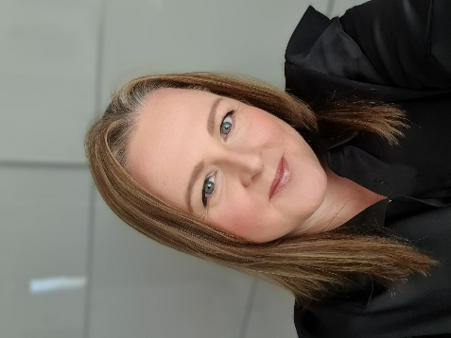
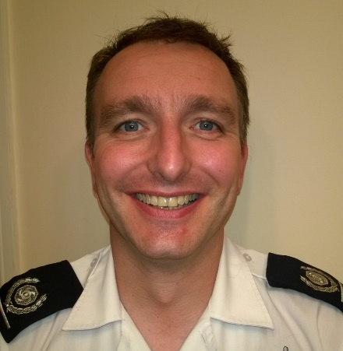
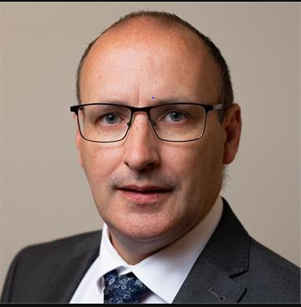
About the Team
Sally Conquest (MCIPS)
National ICT Category Lead – National Procurement Hub
Ian Taylor
Senior User and Business Change Lead (Fire) for the National Fire Chiefs Council (NFCC)
Emergency Services Mobile Communications Programme
Chris Else
Assistant Director Resilience – Kent Fire and Rescue Service
Member of NFCC Ops Communication Strategy Board and lead on supplier engagement

Slide 6
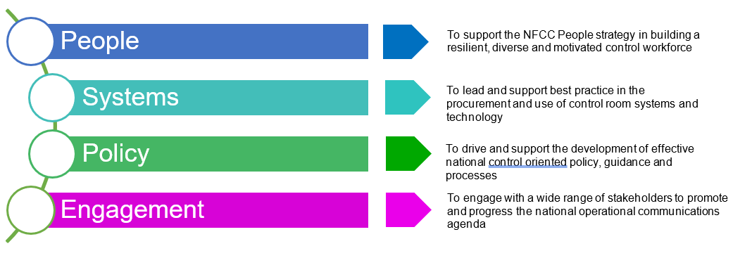
Operational Communications Strategy Board
Note: Chair of OCSB is Ben Norman – Deputy Chief Fire Officer Greater Manchester Fire and Rescue
Notes:
Operational Communications Strategic Board - Purpose and structure
The OCSB is formed to bring together expertise related to fire and rescue emergency control rooms and operational communications and is intended to provide an intelligent client function overseeing operational communications matters on behalf of the Fire and Rescue Service. The purpose of the Board is to identify and share good practice in both specification and operation of control room systems and to ensure that FRS have access to, and can use, effective operational communications systems. It will promote consistently high standards of operational performance throughout the UK FRS. The Board will also provide oversight for national projects or programmes related to control provision, for example development of guidance for the operation of control rooms being developed under the Fire Control Guidance project, Firelink and the Emergency Services Mobile Communications Programme.
The Board, in conjunction with the Mobilising Officers Group (MOG) as the subject matter experts, will advise NFCC National Ops Coordination Committee, via the NFCC Strategic Lead for Operational Communications, on matters relating to Fire Control functions.
The OCSB will ensure that all matters related to the effective operation of fire and rescue emergency control rooms are considered. The MOG will provide subject matter expertise for operational matters in particular.
Working groups constituted under the OCSB will be for specific, time limited projects or tasks and will define their own meeting patterns. Working groups will define their terms of reference based upon the scope set by the OCSB and present them to the board for approval.
Chair is Ben Norman Deputy Chief Greater Manchester Fire and Rescue Ben Norman - Greater Manchester Fire Rescue Service

Slide 7
Operational Communications Strategy Board
Key Priority 7 – “Control room system suppliers monitoring and high level national business requirements for control room systems and equipment”;
Aims and intended outcomes;
Increase sector situational awareness and understanding;
Leading to greater levels of efficiency, intelligence and consistency of fire service control rooms;
Allow future technology to be more easily and more efficiently implemented across the sector.
Notes:
Aim - Development of a central national record of control room supplier and equipment information maintained and accessible to FRS.
An agreed set of high level business requirements, that detail the minimum viable set of requirements for CAD, ICCS and associated control room systems.
Outcomes: This information is intended to increase sector situational awareness and understanding leading to greater and levels of efficiency, intelligence and consistency of fire service control rooms.
It will also allow future technology to be more easily and more efficiently implemented across the sector. Need to consider integration and interoperability also.
This day is intended as the start of a refreshed relationships with suppliers -

Slide 8
Commercial Overview
Mission of the NFCC Procurement Hub:
“To support the goals and diversity of the Fire & Rescue service through the delivery of transparent and inclusive collaborative opportunities that provide optimum value to end users and the public purse.”
https://www.nfcc-procurementhub.org.uk/
Key Principles:
Standardised Requirements;
Aggregated Volumes;
Collaboratively managed contracts and suppliers.
ICT Category Lead role – Current project priorities:
Multi Agency Incident Transfer (MAIT);
ESN;
Collaborative Police and Fire e-procurement system and contracts database;
Supporting delivery of Key Priority 7 for OCSB;
Hardware/software collaboration across the sector.
Notes:
Vision The vision of the NFCC is to improve safety in communities by working collaboratively with fire and rescue services, promoting national approaches where they work best. Procurement is a vital part of this collaborative intent
NFCTP – formed in 2016 in response to the fire ministers reform agenda, chaired by Ann Millington, Chief Exec of KFRS. Consists of 6 Chief Fire Officers/Chief Execs category sponsors, and six cat leads from across the sector – ICT, Fleet, Ops, FM/Property, Professional Services and PPE/Clothing

Slide 9
Commercial Overview
External Factors - Financial
Financial crisis impact on Market
We are aware of price increases to the suppliers – to be raised in afternoon session.
Financial constraints within the fire sector:
Consider collaborative opportunities;
Consider reducing any ‘gold plated’ requirements;
Ensure fair terms – not all risks rest with the supplier;
Continuous supply chain / financial monitoring in contract;
Allow market to assist with outputs based requirements;
Ensure ‘continuous improvement’ worked into Contract to deliver longer term benefits, enable innovation to meet changing technology and customer requirements, and ensure we do not stand still or become constrained;
Note: Always consider whole life cost in your procurement projects
Notes:
For example, technology such as AI, Internet of things or generally customer expectations to be able to engage with us in a simpler way!

Slide 10
Niche supplier market, although a number available offering differentiated service offerings;
Difficult for suppliers to break into the market due to capital costs, infrastructure and the niche service provided;
ESN restrictions make it more difficult for suppliers to enter market, particularly with fully cloud solutions;
Customer loyalty and Bluelight experience make it difficult to enter market
Threat of new entrants
Moderate number of suppliers with services differentiated to increase Suppliers competitive advantage;
Switching costs are high, increasing supplier power;
Not just blue light, but other services requiring dispatch systems;
May be limited number of substitutes offering bespoke needs of the fire sector
Moderate level of competitive rivalry, mainly due to the high outlay and long contractual terms, due to the high switching costs.
Suppliers wishing to break into the Fire Sector will be highly competitive.
Customer loyalty can be high, with long term agreements in place, resulting in suppliers not being afforded the opportunity to compete.
Although a limited market, a number of suppliers trying to break into particular blue light sectors, increasing Buyer Power – particularly if current uptake is low in sector;
Spend is high, with long contractual term;
Good competitive
opportunity in this space
Buyer
Power
Supplier
Power
Threat of substitutes
No threat of substitutes for such a system, other than a manual process.
Notes:
Threat of Subs
Buyer Power
Supplier Power
Threat of new entrants
= Comp

Slide 11
Commercial Overview
Industry feedback
Expectations of long term fixed pricing not feasible. Risk premium will be built into cost…
Early market engagement seems to be feared…
Contractual Terms not appropriate/fit for purpose for market…
Future roadmaps and requirements not always considered…
Tender publication over holidays not good…
Short timescales for tender return may result in no bid…
Constant re-use of ‘old’ or out of date specifications…
Short delivery timescales = risk…
CMA report 2/12/22 – one competitor “told us that the trend towards cloud-based deployment is strongest in the fire and rescue sector, where customers tend to ask for this as a managed service.”
Notes:
Some of comments fed back from suppliers within the sector….

Slide 12
Market engagement
Market engagement is a process that allows you, at all stages of procurement to:
communicate your needs or requirements to suppliers
openly and transparently discuss possible solutions
stimulate innovation in the design and delivery of the solution.
So spend more time explaining where you want to get to,
and then let suppliers come up with the how.
Notes:
May hear this afternoon that we need to move more towards outcomes as opposed to over specifying our requirements….. We are one sector, all turning out resources, so shouldn’t differ, albeit for localised integrations for example

Slide 13
Benefits of engagement
Used well, market engagement can:
change and improve the way you plan and manage procurement;
improve your understanding of the market and help you to become a more intelligent customer;
increase your trust and credibility with suppliers and become a customer of choice;
create the market conditions needed to deliver the best solution;
help to identify opportunities for innovation that last throughout the term of contracts and into future contracts, prevents stagnation.

Slide 14
Let’s get engaged! When?
You can engage with the market at any time, from the early pre-procurement phase, during a tender and at any other time during a procurement process. There is no limitation on when you can engage, as long as you align with the principles of non-discrimination and transparency:
Trust suppliers to innovate, it is in their interest as well;
Record discussions;
Take steps to ensure your integrity, for example, giving the same information to all suppliers;
Give equal access to all suppliers and treat all suppliers the same.
Be fair, open and transparent;

Slide 15
Routes to Market
Limited suppliers and solutions
Open / Restricted Competition
Full scope to determine requirements and T&C’s
May require legal assistance in drafting contract
Frameworks
Pre-selection already completed
Crown Commercial Services (CCS) Vertical Application Solutions (VAR) – RM6259 – Due to be awarded in January 2023
Blue light solutions Lot 5 - covering CAD and ICCS solutions
Support from CCS offered to running competition under this framework.
https://www.crowncommercial.gov.uk/agreements/RM6259
Direct Award
Exceptional circumstances
The rules are changing in 2023 – this will give us greater opportunity to deliver better commercial and procurement outcomes.
Notes:
VAR framework is set to include all major suppliers in the market. To be announced by early Jan 2023.
Whilst saving time on an open tender, need to consider use of a framework. Word of warning This is a new framework– As with any framework – these are generic in nature with regards to Terms and Conditions, and full due diligence should be undertaken to ensure these are fit for purpose for your requirement. Requirements within frameworks are high level, and ‘minimum requirements’. These need to be tailored to suit a critical system such as CAD/ICCS. Myth that it is ‘easier’ to go to market under a framework as the work is already done for you….. Not the case!!! The onus is on the buyer to ensure that the requirements and T&C’s are considered in full before going out to tender.
Continue to assess financial strength and sustainability – not all FW owners will do this!
Two examples are the minimum requirements stipulate suppliers should have Cyber Essentials basic, and NOT Cyber Essentials Plus
Secondly, SLAS’s need determining. These are not predefined for you……

Slide 16
The contract – some basics
Just a sample of things to think about…
Licences
Financial strength
Innovation & continuous improvement
Assets
IPR – do we need to own it?
Liabilities
Sustainability
KPI’s / SLA’s
Accountability
Commercial model (e.g incentives? gain share?)
Clearly defined requirements
Equality, Diversity & Inclusion
Insurances
Corporate Social Responsibility
Warranties/ guarantees
Success / failure measures
Notes:
When developing contracts – here is an example of some of those things that need consideration over and above the ‘technical’ requirements. These often get forgotten and can result in problems further down the line….

Slide 17
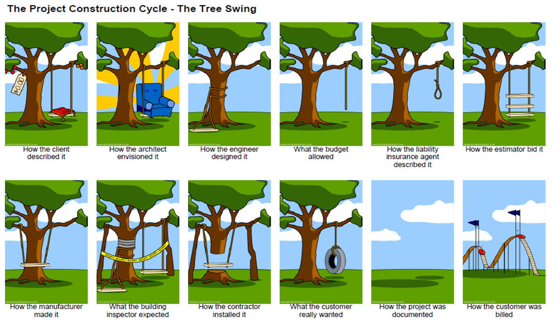
Pitfalls of specification development

Slide 18
Break Time!

Slide 19
Working together – a blunt assessment
The fire sector working together has delivered benefits both financial and operational in a lot of examples, do we learn from those?
Working together is patchy and uncoordinated leading to a patchwork of arrangements across the sector, difficult for suppliers to engage
Poor terminology and understanding of terminology across the sector – Partnerships, consortiums, buddy, fallback, contracts etc. etc. – Ian will add to this in a moment.
Services don’t give sufficient time to consider working together – it takes on average 2-3 years to implement a new CAD/ICCS, we would need to add another 1-2 years to work out collaboration or partnerships – strategic planning requirement = 3 to 5 years
Some partnership arrangements have not worked, is the sector honest about this?
Same benefits needed across the sector with different organisations (funding, resource, size, leadership, geography) how do we rationalise this?
Fire Control people, systems and facilities deliver more fire service mission critical services than fire stations, prevention and protection, and support teams but often get the least attention and investment. This does not make business sense

Slide 20
Working together – a blunt assessment # 2
Like human relationships, partnerships come and go
– it’s not something to be embarrassed about
Think about three stages of partnership / consortia working:
Getting together
Staying together
Dissolution
Consider a partnership agreement – it provides surety all round.
Do you need break clauses / points?
Different partnership / collaboration models
Separate company
Outsourced to another FRS
Joint partnership
Lead Authority
Mobility within and around the above – the landscape will not remain static

Slide 21
Open discussion / Lessons Learned sharing / Q&A

Slide 22
Close
See you at 1pm!
Please remember to use the SECOND Teams link for the Supplier session!

