Slide 1


NFCC Task &
Finish Group
January 2023
V1.1
Version | Date | Description of Change
1.0 | 20.01.2023 | Issue to Elli Nikolaou
1.1 | 07.01.2023 | All reference to ‘NSTFG’ amended to official title of ‘FM & Construction NSTFG’
1.2 | 09.06.2023 | Diagrams updated to reflect National Strategic Task Finish Group.

Slide 2
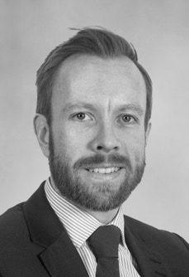
Contact Details
For all initial engagements, and to set up the first round of workshops please contact Dan Jermin via:
Email: Daniel.jermin@fgould.com
Mobile: 07812318144
Dan Jermin
National PMO Lead

Slide 3
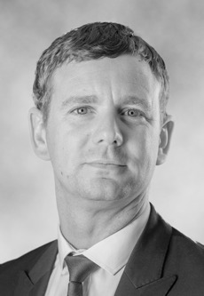


Introduction
Dan Jermin
National PMO Lead
Tom Aram
Regional Lead
Alex Wakefield
National Framework Lead
David Gilbey
Regional Lead

Slide 4
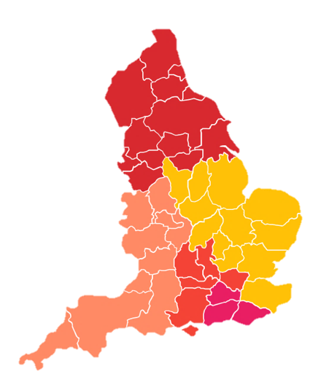
UK Fire and Rescue Services & F+G Offices
South Western Region
Avon
Cornwall
Devon & Somerset
Dorset & Wiltshire
Gloucestershire
Guernsey
Jersey
Isles of Scilly
North Eastern Region
Cleveland
Durham
Northumberland
Tyne and Wear
North Western Region
Cheshire
Cumbria
Isle of Man
Lancashire
Greater Manchester
Merseyside
Northern Ireland
East Midlands
Derbyshire
Leicestershire
Lincolnshire
Nottinghamshire
Northamptonshire
Wales
Mid and West Wales
North Wales
South Wales
Scotland
Scottish Fire and Rescue Service
Yorkshire & Humberside Region
Humberside
North Yorkshire
South Yorkshire
West Yorkshire
Northern Ireland
Northern Ireland Fire and Rescue Service
South Eastern Region
Buckinghamshire
East Sussex
Hampshire & Isle of Wight
Kent
Oxfordshire
Royal Berkshire
Surrey
West Sussex
Eastern Region
Bedfordshire
Cambridgeshire
Essex
Hertfordshire
Norfolk
Suffolk
West Midlands
Hereford and Worcester
Shropshire
Staffordshire
Warwickshire
West Midlands
London
London Fire Brigade
Faithful+Gould Office
Northern
Eastern
London & South Central
Western
South Eastern
4

Slide 5
FM & Construction National Strategic
Task and Finish
Group

Slide 6
Proposed Structure and Operating Model
Fire & Recue Service Project Teams liaise with F+G Regional Leads.

Slide 7
Structure and Operating Model
Support with Access Agreements
Northern
Eastern
London & South Central
Western
South Eastern

Slide 8






FM & Construction National Task and Finish Group Vision
Establish a cohesive national structure and process for the decarbonisation of the Fire and Rescue estate to include:
Setting a baseline
and understanding of the
estate profile
Support funding applications
such as Public Sector Decarbonisation Scheme (PSDS)
Manage and deliver
decarbonisation projects
through to completion
Support the NSTFG
as a critical friend
Have national coverage with
local delivery
Establish a flexible and compliant approach to call off commission’s

Slide 9






Progress To Date
Progress to January 2023
Faithful+Gould
successfully secured position as
energy/decarbonisation partner
Pagabo framework
to be used for all appointments
Now in a position to proceed
with all organisations
(individual appointments)
Model briefs and fee structures have been drafted
Initially focusing on Heat Decarbonisation Plans and Salix
Mobilising
resource nationally

Slide 10
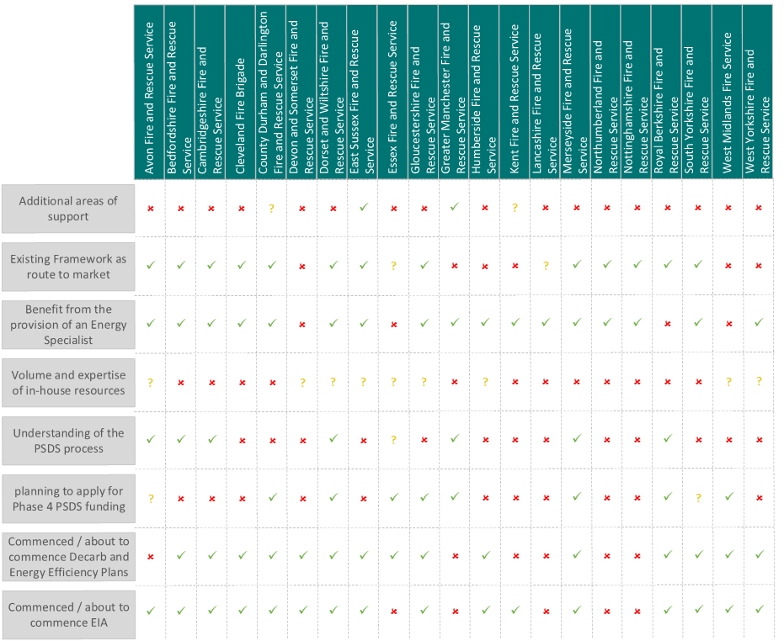
Survey Analysis

Slide 11





Key Considerations
Mobilisation
We are proposing a two stage approach to the mobilisation process.
A questionnaire and a meeting with each region.
Timescales
Ordinarily we would produce a heat decarbonisation plan and then apply for Salix funding. Given potential time constraints, we are considering running the two in parallel to ensure funding is not missed.
Energy
Intensity
  The Salix funding value is determined by the amount of carbon saved,
  so the energy intensity of the building is essential to determine.
Financial Contribution
  The financial contribution is a minimum of 12% and can be more if we can’t achieve the Lifetime Carbon Threshold.

Slide 12

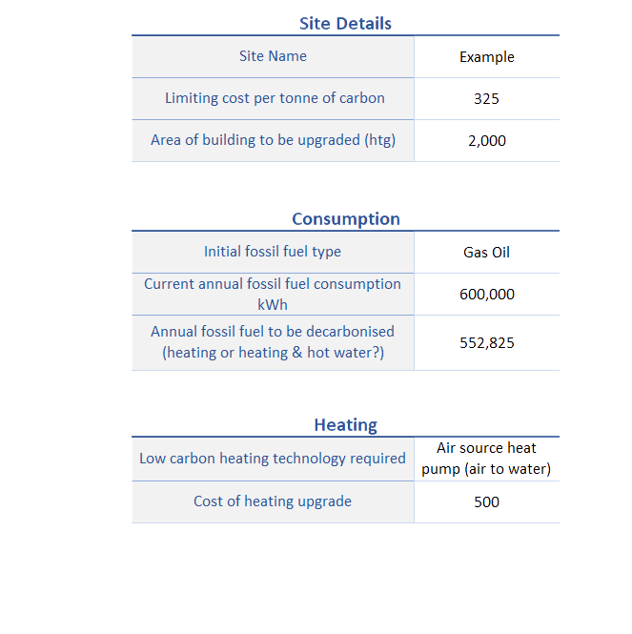
Salix - Funding Calculator
Results
Total Project Cost: | £2,215,238
Maximum funding: | £1,547,874
Client Contribution: | £667,634

Slide 13
Decarbonisation Process
Data capture circulated to services
Proceed with decarbonisation plans
Model energy data and complete site audits
Complete decarbonisation plans
Initial meeting
with services
(workshop
and time input)
Project Delivery
Obtain energy data and input into calculator
Ensure Salix requirements can be met
Complete and Submit Salix applications
Agree decarbonisation plan and PSDS requirements
Key
Decarbonisation
Plans
Salix
PSDS
Gateway

Slide 14






Next Steps
Support business case/funding support/project delivery
Appointments agreed and site audits completed
Timescales to be agreed for delivery of first phase
F+G data capture to be circulated and workshops completed
Pagabo access agreements to be signed and returned
Points of contact
to be shared

Slide 15
Questions
& Discussion

