Slide 1
Annabel Harford
Environmental Manager
Public Sector Decarbonisation Scheme Phase 1
Avon Fire & Rescue Service
Notes:
- Summary of the grant we received & how it has been spent
- Overview of process from pre-application to commissioning
- Success factors, challenges and impacts

Slide 2
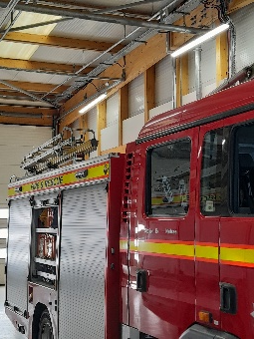
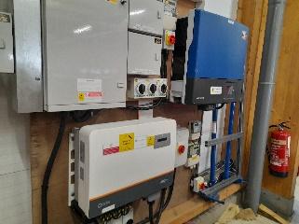
PUBLIC SECTOR DECARBONISATION SCHEME: GRANT SUMMARY
£823,670 awarded
12 Fire Stations, Control & Technical Centre
Range of measures:
  Energy efficiency
  Low carbon & renewable technologies
  Electrical infrastructure upgrades
Conditions included:
  Heat Decarbonisation Plan (for 9 buildings)
  Tender & procurement
Notes:
50% of AFRS sites
Measures:
Energy efficiency: Insulation, BMS, metering, LED lighting, double-glazing
Low carbon & renewable technologies: ASHPs, Solar PV & Thermal, Battery Storage
Electrical infrastructure upgrades: DNO & internal

Slide 3
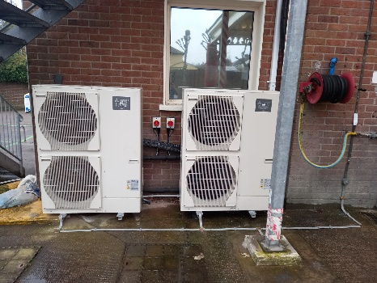
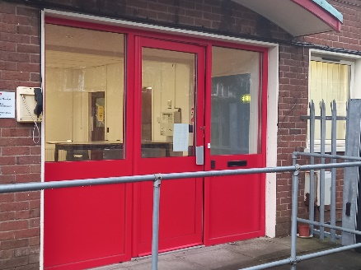
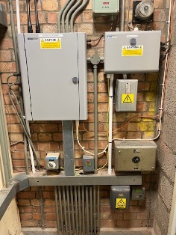
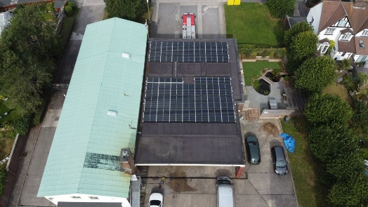
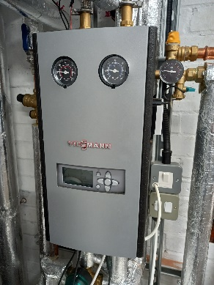
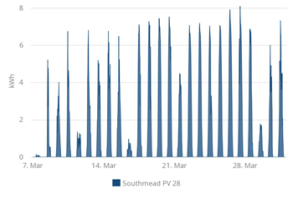
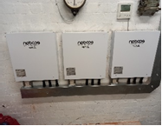
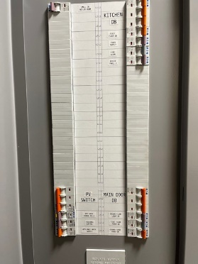
SOUTHMEAD FIRE STATION
Double Glazing
Air Source Heat Pump (28kW)
Solar PV (28.5kW)
Electrical Distribution
Upgrade
Solar Thermal (3.87kW)

Slide 4
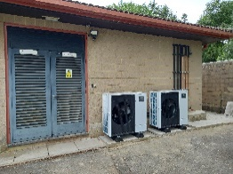
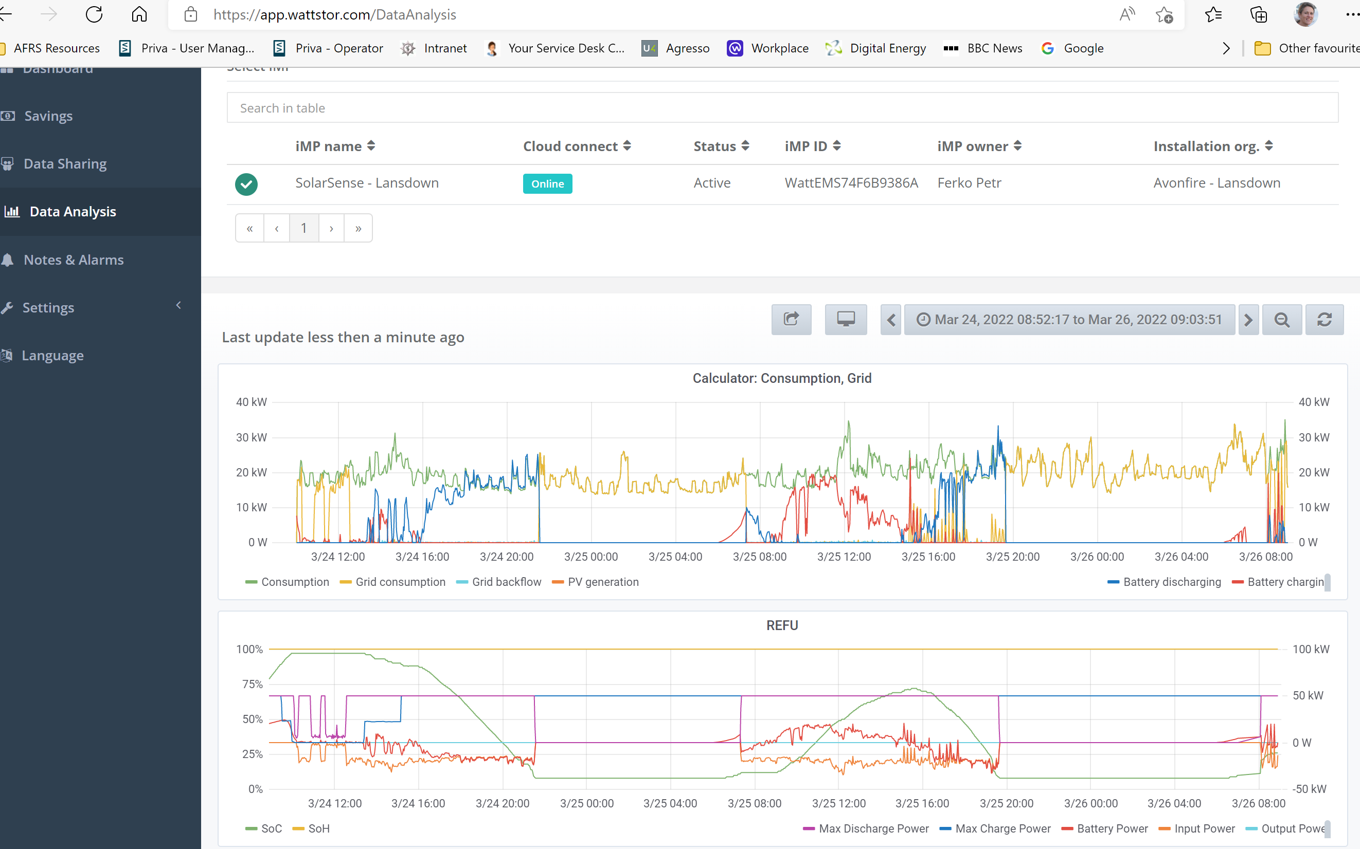
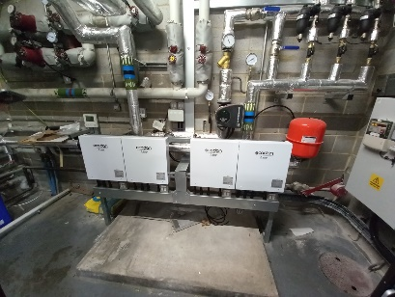
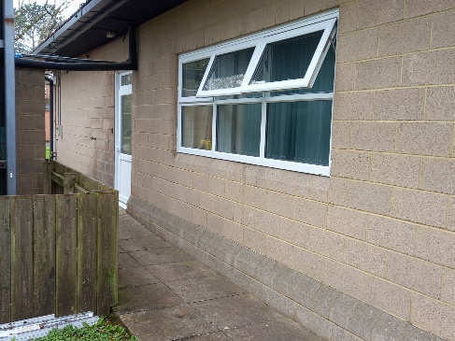
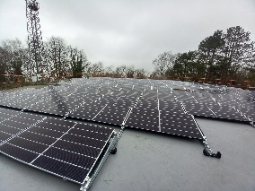
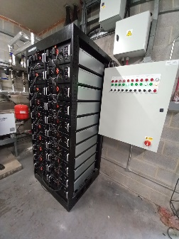
LANSDOWN CONTROL CENTRE
Air Source Heat Pump (33kW)
Heating Pipework
Insulation
Battery Storage System (108 kWh)
Double Glazing
Solar PV (95kW)

Slide 5
PROCESS
Pre-application (September 2020)
  Project definition, costs & savings calculations
  Low Carbon Skills Fund (application support)
Application (November 2020)
  Pre-tender application
  Project management, governance & procurement processes lined up
Award (February 2021)
Delivery (deadline September 2021; extended to March 2022)
  Procurement tender & use of existing supply chain
  Low Carbon Skills Fund (Heat Decarbonisation Plan & Project Delivery)
  Installation works
  Commissioning
Notes:
Pre-application
Project definition: wish list, priority sites, surveys (heat loss, energy audits, renewable feasibility etc),
Indicative quotes, comparative costs & savings calculations
Application
Templates, approval processes, project folders, procurement timeline & responsibilities
Delivery
Procurement: Rapid tender for a long-term low carbon & renewable energy technology partner – compliant with AFA CPR/OJEU
LCSF (HDP / PD) – issue with deadline March 2021
How we managed the experience of installing the measures while providing ongoing services
Close liaison with sites, Control & IT – vehicle access, security
Business continuity planning in place – alternative locations, fall back to radio comms
Generators – DNO

Slide 6
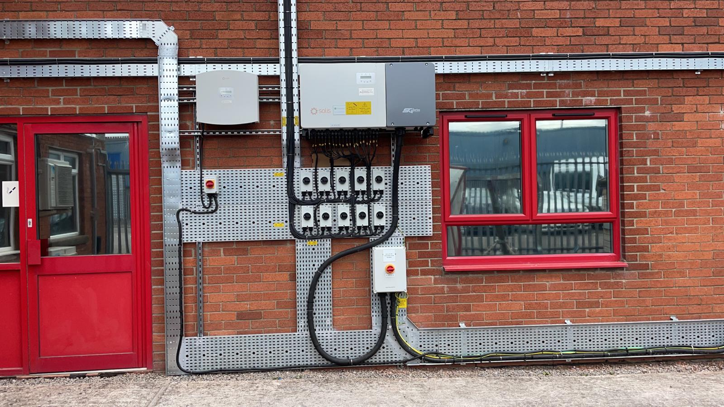
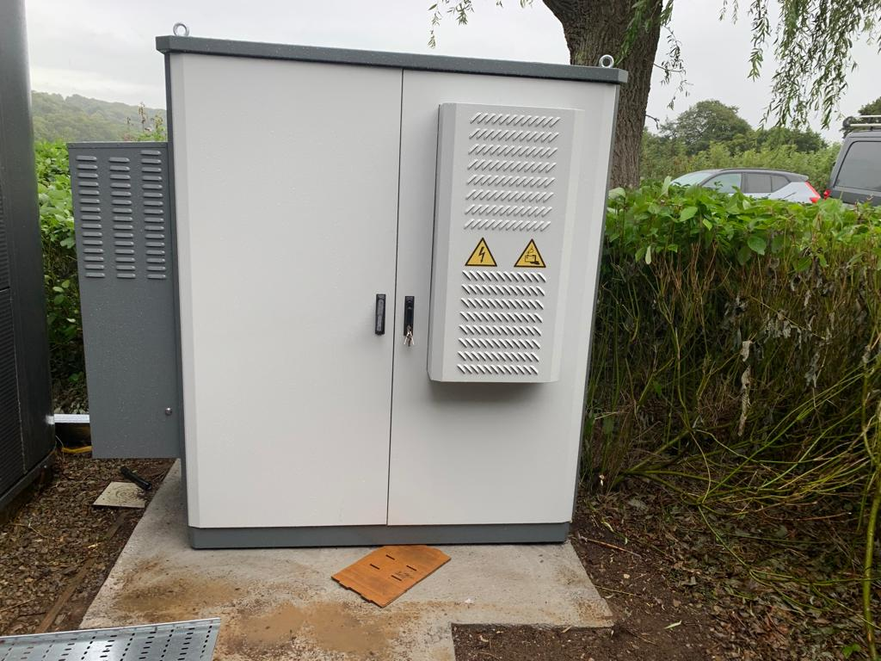
SUCCESS FACTORS
Engagement from Day 1 with key stakeholders:
  Internal: Procurement, Property Services & Senior Management
  Existing supply chain, contractors & consultants
  Distribution Network Operator (Western Power)
AF&RS single point of co-ordination
Technical work-arounds
Good communications & relationship with Salix Relations Manager
Notes:
SPOC: all aspects – application, finance, procurement, PM, delivery, contractor mgt etc
Technical wk arounds:
To reduce elec upgrades needed and solutions to local grid supply limitations

Slide 7
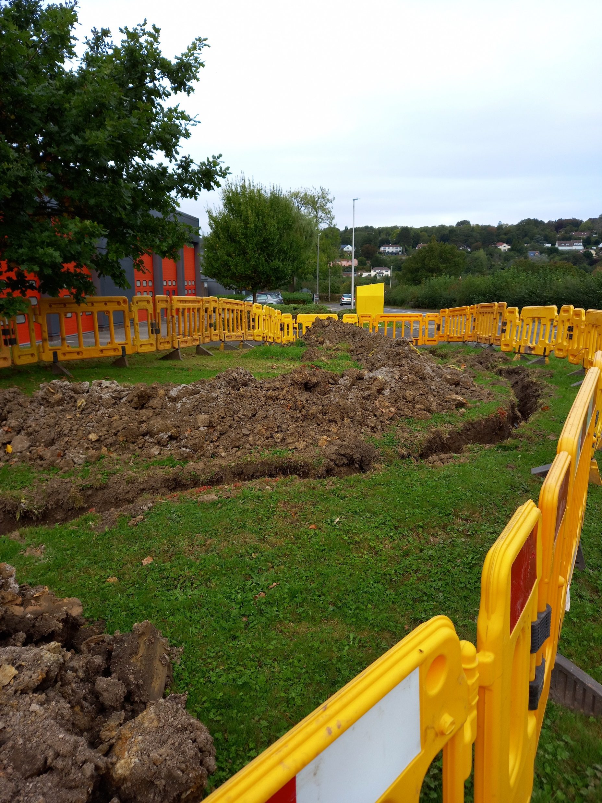
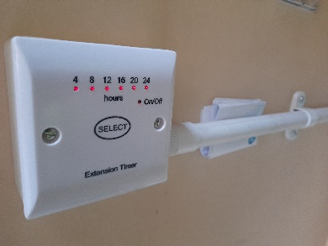
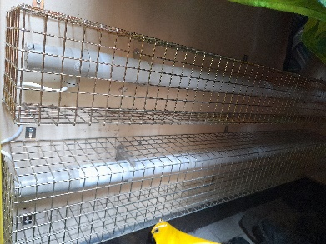
CHALLENGES & LESSONS
Resources required for grant administration & project management
Site & sub-station electrical capacity issues
Supply chain delays & price increases
Distribution Network Operator (Western Power) delays
COVID delays & ventilation requirements
Deadlines & time-scales
Notes:
Common challenges to many PSDS recipients & Many factors outside our control
Admin:
Info requirements
Monthly reporting – proj & financial
Internal reporting & approvals
Audits
underestimated. Had to deprioritise other issues – v aware climate change and ecol emerg not just about carbon
Electrical capacity/supply issues
Consideration for Govt prior to further decarb funding
DNO/WPD – overwhelmed by public sector bodies. Bedminster still on-going.
COVID Irony – ventilation
Deadlines/timescales:
Creative in accelerating approval & governance processes – get buy in/exceptions/delegations
Push contractors hard – difficult as everyone under pressure
On-going re-assessment of risks & mitigation options in consultation with contractors & DNO - & extension request for specific project elements

Slide 8

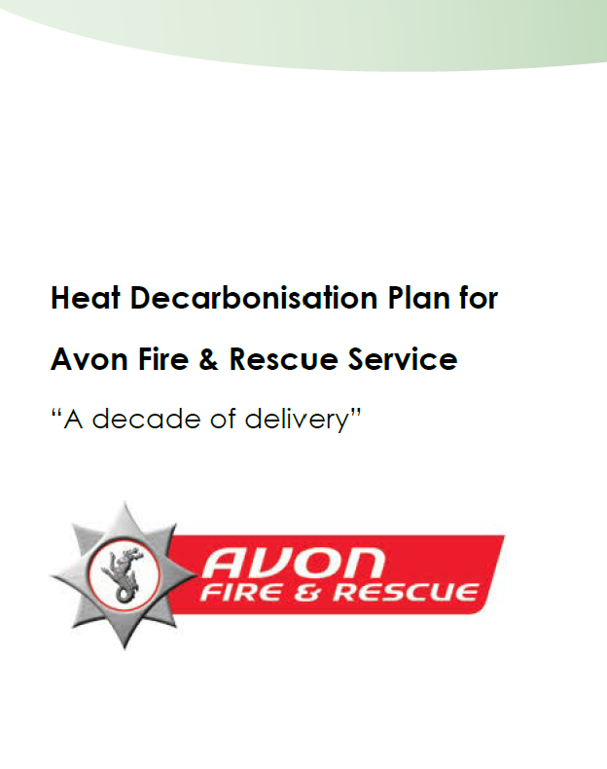
IMPACTS & BENEFITS
Accelerate progress towards our Net Zero by 2030 goal
Buildings more comfortable for users
Predicted 531,000 kWh & £75,000 energy savings
Higher profile of Net Zero & environmental issues
Notes:
Est. 7% reduction of AFRS’ total carbon emissions : 86T CO2e per annum
Greater self-generation
Already seeing 40% savings in energy consumption across those PSDS sites Apr-Sept 2022 compared to same 6 months last year… summer PV, no ASHPs etc
Energy price increases… elec-powered heating & HW v. expensive. Predicted £ savings now unlikely
Higher profile
Internal
– core to Service Strategy;
- unanimous support from AFA
External
– HMICFRS – innovation & best practice
AFRS – leading in Emerg Services
Climate leaders – locally & Cabinet Office COP 26 case study
- REGEN award

