Slide 1
GMFRS Case Study
Public Sector Decarbonisation Scheme Phase 1 and 3
Mathew Chard

Slide 2
Overview
PSDS phase 1 schemes
PSDS phase 3 – ongoing project
PSDS challenges
Quick wins and opportunities

Slide 3
PSDS Phase 1
Undertook grant funding bid as part of a Greater Manchester Combined Authority (GMCA) city-region wide bid
Due to challenges with survey quality and timescales, initial GMFRS phase 1 bid focused on solar PV and battery storage as well as LED lighting
Total grant funding award for GMCA led bid of circa. £78 million split across a number of GM based local authorities and partners

Slide 4
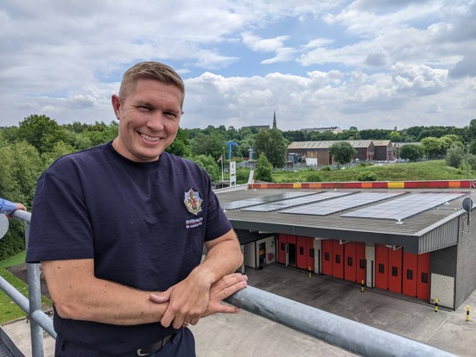
PSDS Phase 1
Solar PV at 2 fire stations and LED lighting installed at 18 stations
Total project value – circa. £620,000
Annual tCO2e saving – 31.7 tonnes
Annual energy saving – circa. £135,000
Battery storage element of both PV schemes abandoned at procurement stage

Slide 5
PSDS Phase 1 Procurement
Surveys funded via Low Carbon Skills Fund with funding divided between partners based on estate carbon footprint
Solar PV and battery storage contractor procured via North West Construction Hub
LED lighting scheme delivered through existing, long-term design & supply partnership with Solarcrown and installation partnership with Frontline NW

Slide 6
PSDS Phase 3
2 surveys conducted through existing revenue budget for low carbon heating solutions at 2 stations
Bid submitted and grant funding awarded for air source heat pump technology at Oldham FS
  Grant funding - £255,808
  Match funding required - £197,784
  Annual tCO2e saving – 39.36 tonnes
Project still at design stage due to alignment requirements with wider estates refresh programme (e.g. rest facilities, station gyms)
Challenges still to overcome include grid requirements, supply chain, alignment with wider estates programme

Slide 7
PSDS Challenges and Considerations
Achieving lifetime cost of carbon feels extremely difficult for FRS estate
Contextual issues such as supply chain and availability of contractors is a significant challenge to design and delivery
Timescales for bid submission and delivery are challenging and the process is extremely competitive
Consider hidden costs and time pressures such as engagement with grid and planning
Ongoing monitoring and reporting is extremely rigorous – PSDS phase 1 essentially required 2 FTE at GMFRS plus support from estates department and wider stakeholders are various stages of the programme

Slide 8

PSDS Quick Wins and Opportunities
Data access and understanding is absolutely vital in developing the business case for PSDS projects
Some elements of the application are repetitive – good governance and process can overcome this
Develop a strong internal network of key stakeholders to mobilise quickly as and when funding is announced
Utilise existing supply chains and contractors where feasible
Energy surveys of the buildings will go a long way to supporting the development of projects and future bids
If successful, try to develop a positive relationship with Salix Finance if successful and be transparent with ongoing monitoring

Slide 9
Further Information
  Mathew Chard chardm@manchesterfire.gov.uk
  07792 243119
  Hayley Meaker Hayley.meaker@greatermanchester-ca.gov.uk
  07581 476157
  Malcolm Courtney Malcolm.Courtney@greatermanchester-ca.gov.uk
Notes:
EOP7 in place for vehicle washing at sites located near to surface water bodies
Vehicle wash water not considered trade effluent by UU but must be done to a foul sewer
Applies to both standard vehicle washing and charity car washes

